Slide 1
Key findings about how Americans view artificial intelligence
Week of March 23th
Elias Hord

Slide 2
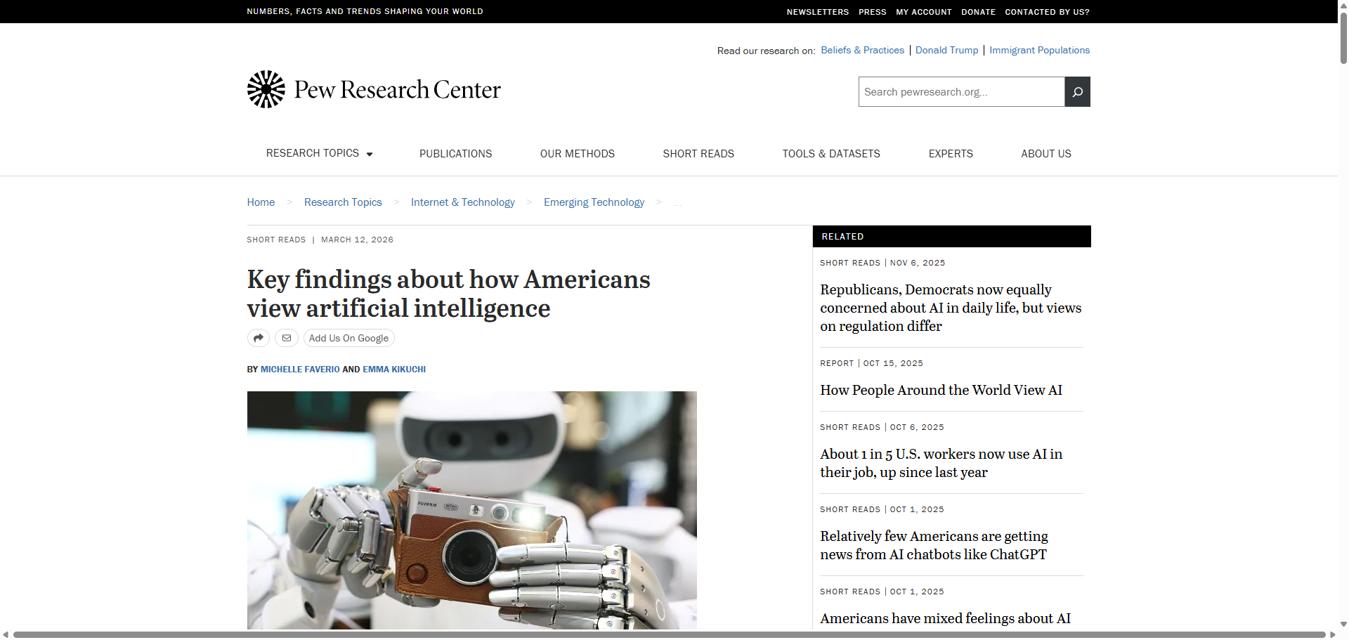
General Information
Article Publication: March 12, 2026
https://www.pewresearch.org/short-reads/2026/03/12/key-findings-about-how-americans-view-artificial-intelligence/

Slide 3
Main Findings and Arguments
Public sentiment is cautious and skeptical
About 50% of Americans feel more concerned than excited about AI, while only a small share feel mostly excited.
Many people see AI as advancing quickly but with uncertain consequences.
AI use is growing, but not universal
Around 21% of workers use AI in some part of their job, up from previous years—but most still rarely or never use it.
AI is becoming more common in everyday life (school, work, healthcare), but adoption is uneven.
Younger generations are more engaged
A majority of teens have used AI tools (like chatbots), though concerns about misuse (e.g., cheating) are widespread.
Mixed expectations about AI’s impact
Americans see potential benefits, especially in areas like healthcare and productivity.
At the same time, they worry about:
Job loss
Loss of critical thinking skills
Ethical and societal risks
Overall attitude: “Interested but wary”
The public is not fully anti-AI or pro-AI—rather, they hold balanced, cautious views, recognizing both risks and opportunities.

Slide 4
Broader Implications for Society
Trust and governance will be critical
Public concern suggests strong demand for regulation, transparency, and oversight of AI systems.
Without trust, adoption could slow despite technological progress.
Potential societal divide
Differences in AI usage (by age, job type, and experience) could widen digital inequality.
Those who use AI effectively may gain economic and educational advantages.
Shifts in education and skills
Concerns about cheating and overreliance indicate a need to rethink education systems, focusing more on critical thinking and AI literacy.
Cultural and cognitive impact
Many fear AI could reduce creativity, human interaction, and independent thinking—raising long-term questions about how people learn and work.
Gradual—not sudden—transformation
Despite rapid headlines, real-world adoption is still developing, suggesting AI’s societal impact will be incremental but significant over time.

Slide 5
Relevance or Potential Influence on the Construction Industry
Slow but growing adoption mirrors national trends
Like the broader workforce, construction is likely in the early stages of AI adoption, with gradual integration into workflows.
Opportunities for productivity gains
AI could support:
Project planning and scheduling
Cost estimation
Risk prediction and safety monitoring
Public openness to AI in practical applications suggests these uses may be more accepted.
Workforce resistance and training needs
Skepticism about AI means construction firms may face:
Resistance from workers
A need for training and education to build trust and competence
Safety and liability concerns
Given the high-risk nature of construction, concerns about AI reliability and oversight will be especially important.
Regulation and public perception
As AI becomes more embedded (e.g., smart infrastructure, automated equipment), public concern about safety and ethics could influence:
Industry standards
Government regulations
Project approvals

